Slide 1
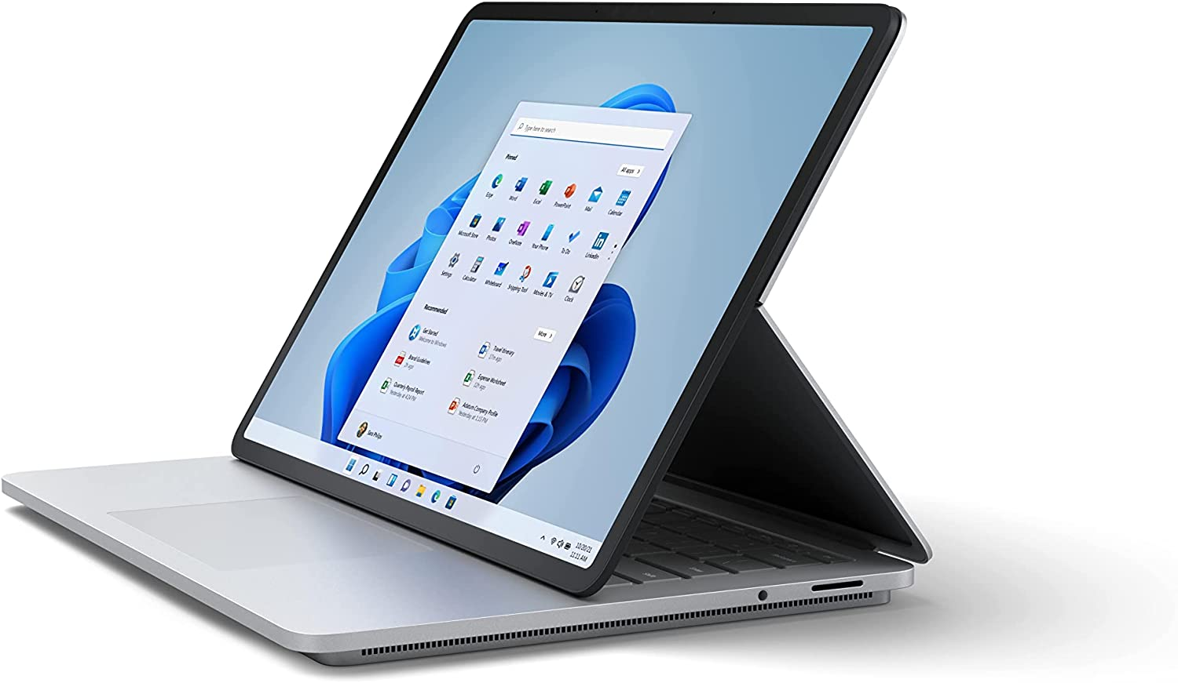
Impacts of computer in daily life
Positive impacts
Computers are commonly used device in many areas. It is an important system for people, especially the people who run organizations, industry, etc. Almost all the things we know is made by or run by computers.
Negative impacts

Slide 2






Positive impacts of computer
Helps to learn new things.
Keeps us connected.
Saves our time.
Positive impacts of computer
Helps to organize data.
Keeps us entertained.

Slide 3

Helps to learn new things
Connect
Gives instant information on any topic in just a single click.
We can learn a new profession by reading websites or watching videos.
We can access worldwide news to keep up-to-date with all of the latest news.
Organize
Entertain
Save time
Learn

Slide 4
Keeps us connected
Save time
Computers help keep you connected with long-distance friends and family over e-mail and social networking .
We can connect with millions of other people who share their interest through social media apps.
Computers helped the Business industry to communicate with people on the other side of the globe without traveling.
Connect
Entertain
Organize
Learn

Slide 5
Helps to save time
We can easily use an online banking site to view our bank balance and pay bills.
We can order almost everything in just a second without going outside of the home.
We can automate the business and other activities using computer and save our time.
Connect
Entertain
Save time
Organize
Learn

Slide 6
Helps to organize data
With the help of computer we can easily organize our daily schedule.
We can organize our Business’s data like which product are selling and which are not.
We can organize our projects and documentation.
Connect
Entertain
Save time
Organize
Learn

Slide 7
Keeps us entertained
With a computer, we can store and listen to millions of songs.
We can watch a thousands of movie to entertain ourselves.
We can watch an endless amount of streaming and online videos from popular sites.
Connect
Save time
Organize
Learn
Entertain

Slide 8
Negative impacts of computer
Affects the physical health.
Changes the Academic performance
Negative impacts of computer
Lessens the social interactions

Slide 9
Affects on Physical health
Interaction
Health
Performance
Poor eye sight.
Weight gain or loss.
Back and hand pains.

Slide 10
Changes the Academic performance
Having trouble in completing projects and home works.
Failing grades.
Not able to give attention to studies.
Health
Interaction
Performance

Slide 11
Lessens the social interactions
Physical
Performance
Interaction
Isolation from family and friends.
Afraid to talk with other people.
Don’t want to stay in public places.

Slide 12
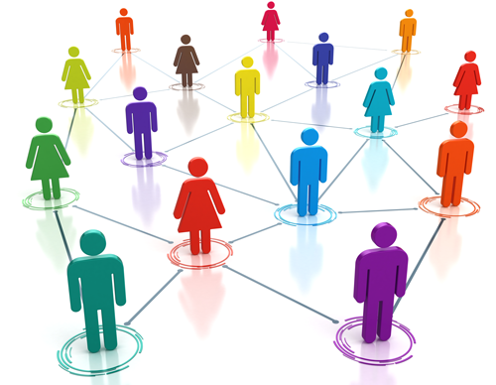
for watching.
Thank you
Presented by: Shishir Bhusal

